Slide 1
Team 1 CS4347.502
Personal Finance Database System
Joshua Newhouse, Miguel de la Rocha, Ahmad Ghafori, Stanley Varghese

Slide 2
System Description
The system consists of three parts:
A database consisting of users and their financial information.
A server application which retrieves and submits data from clients to the database.
A client application which interacts with the server and users.

Slide 3
Database Description (MySQL)
Users → An entity that tracks each unique user in the system.
User_Accounts → An entity that records account information of a unique account associated with user entities.
Transaction → An entity that records a unique financial transaction associated with an account entity.
UserToAccount and AcctToTrans exist to support many-to-many relationships between the users and accounts and accounts to transactions.

Slide 4
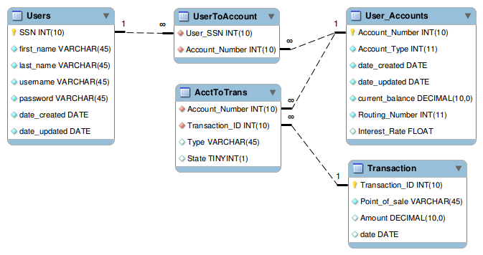
ER Diagram

Slide 5
Client Application (CL/GUI)
Allows a user to perform:
View accounts information.
View transaction information.
Transfer funds from one account to another.
Change the user password.

Slide 6
Server (Java JDBC)
The server connects to the database and subsequently handles client requests:
The server spawns a separate thread for each client connection.
The server authenticates the client via username and password.
The server receives requests from the client, executes SQL on the database, performs data checks as necessary, and returns the results to the client.

Slide 7
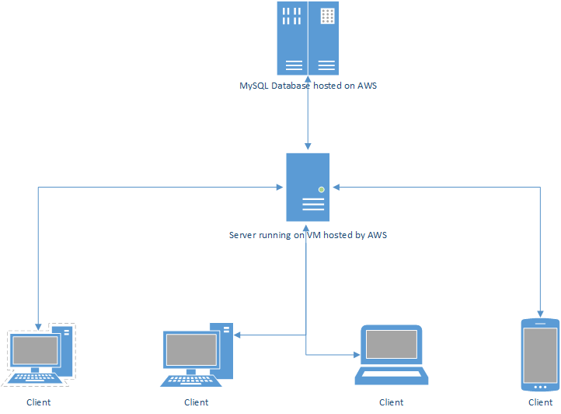
System diagram

Slide 8
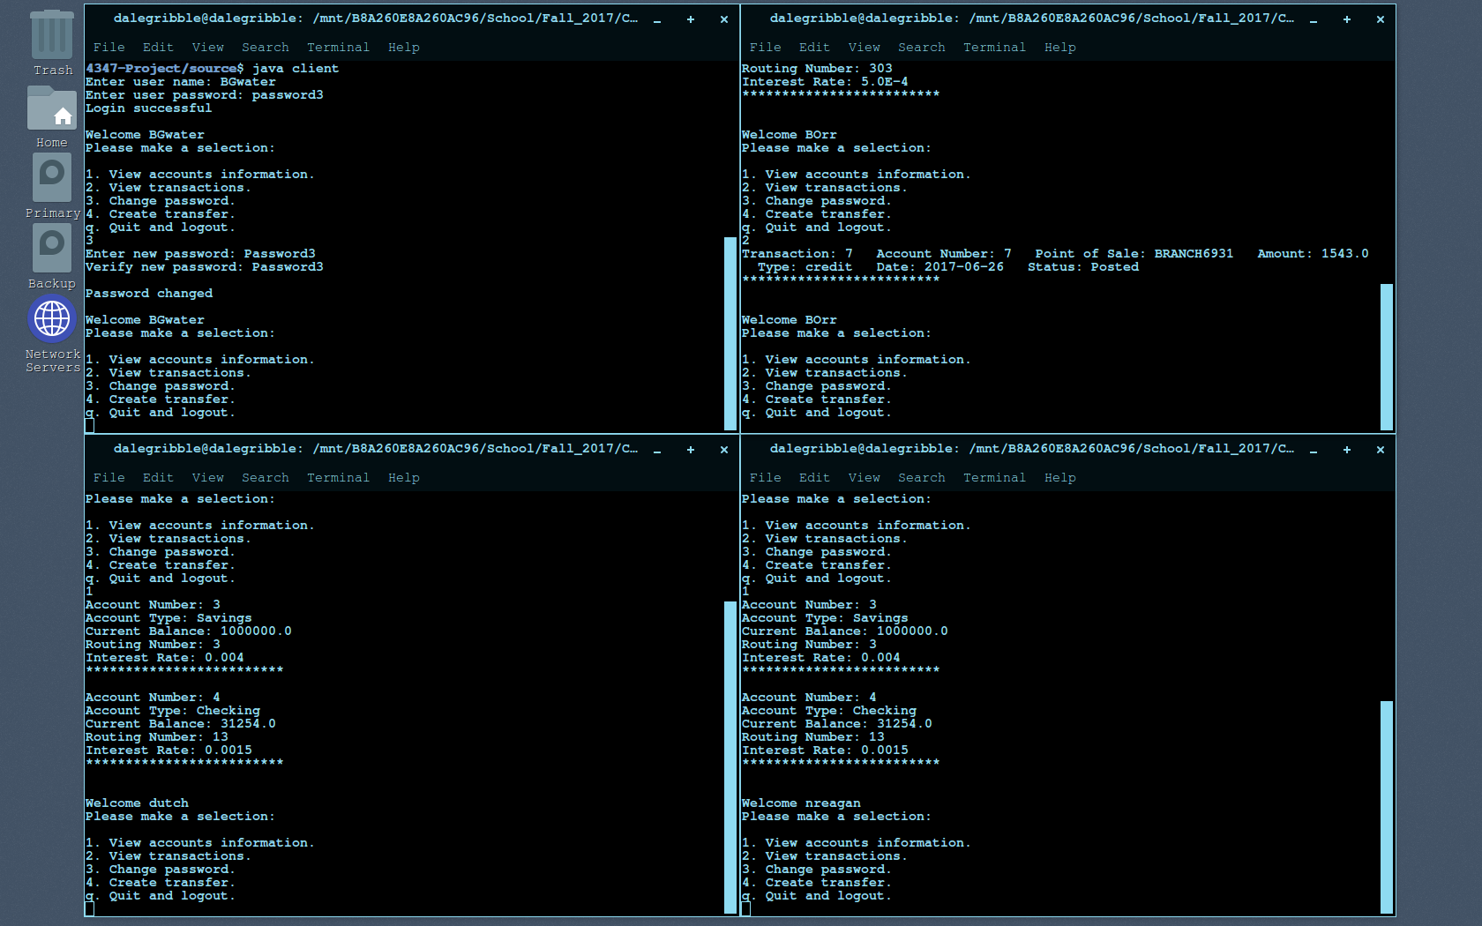
Four CL Clients

Slide 9
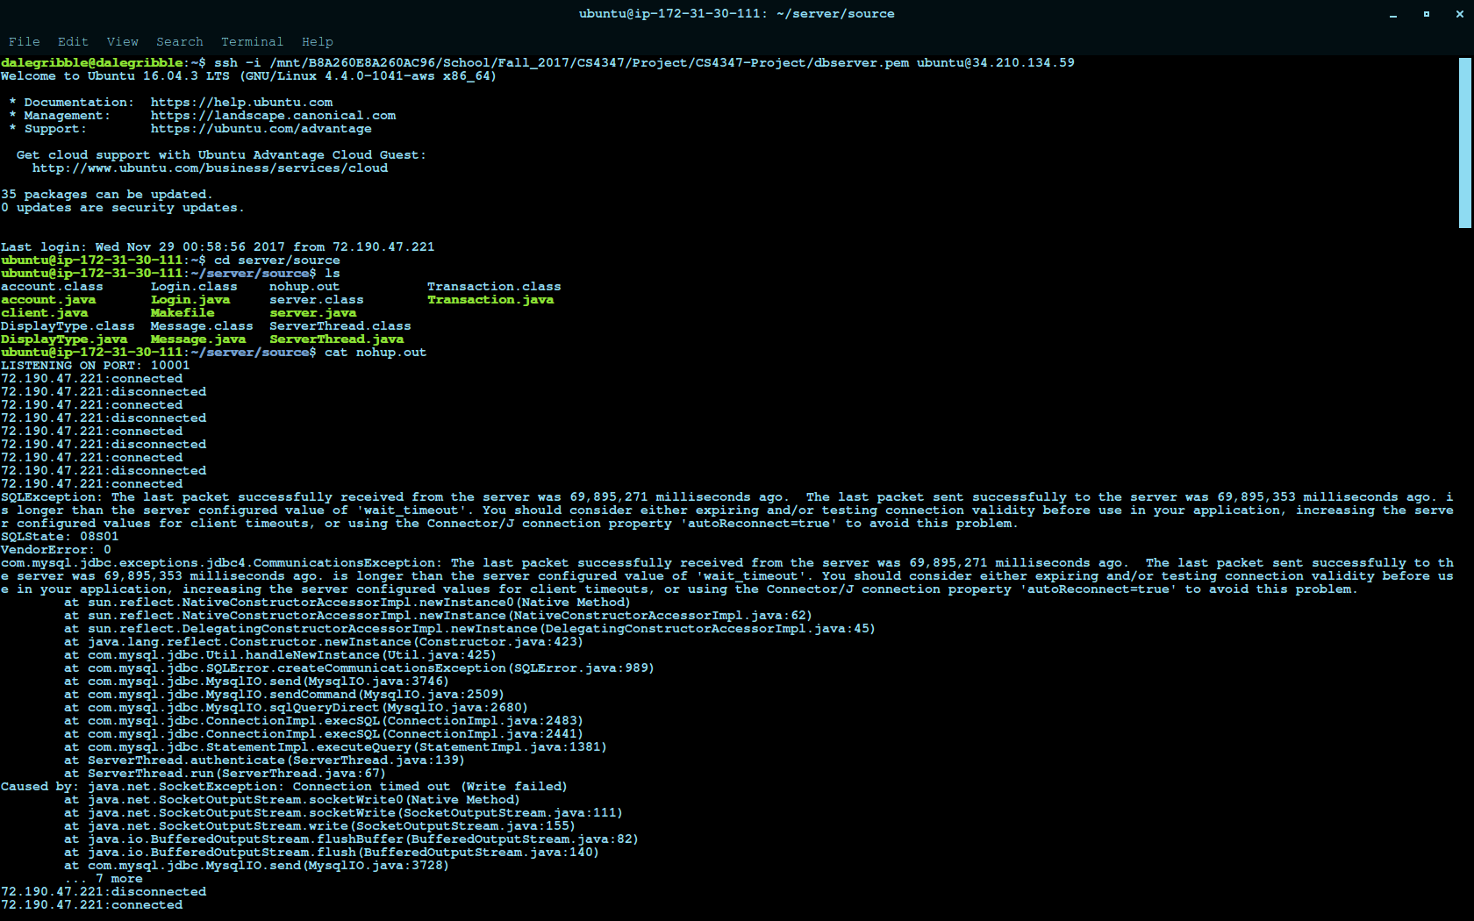
Server Log

Slide 10
GUI
More user friendly
Performs same function as CL client
Current status:
Front end is complete and looking good
Backend communicates well with the database and performs actions as expected

Slide 11
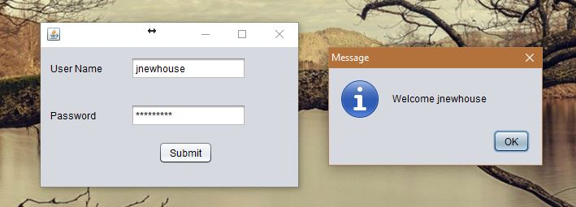
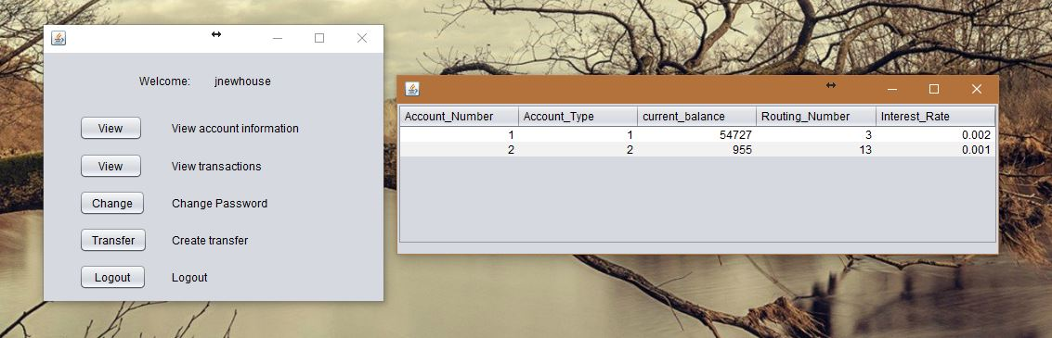
GUI Images

Slide 12
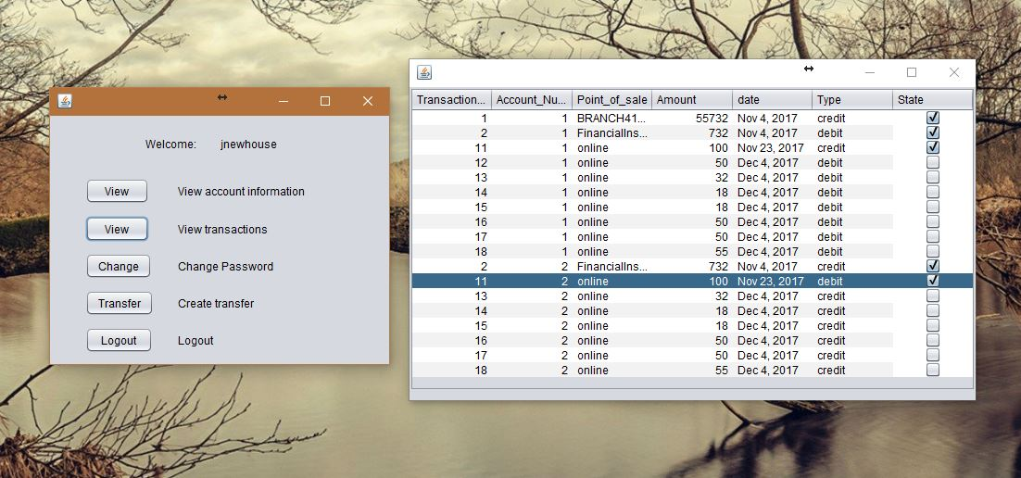
GUI Images

Slide 13
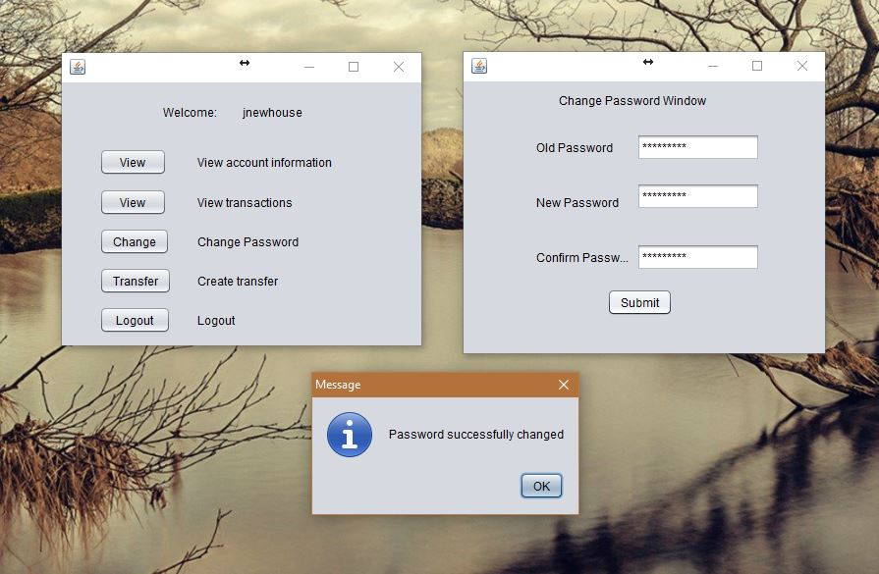
GUI Images

Slide 14
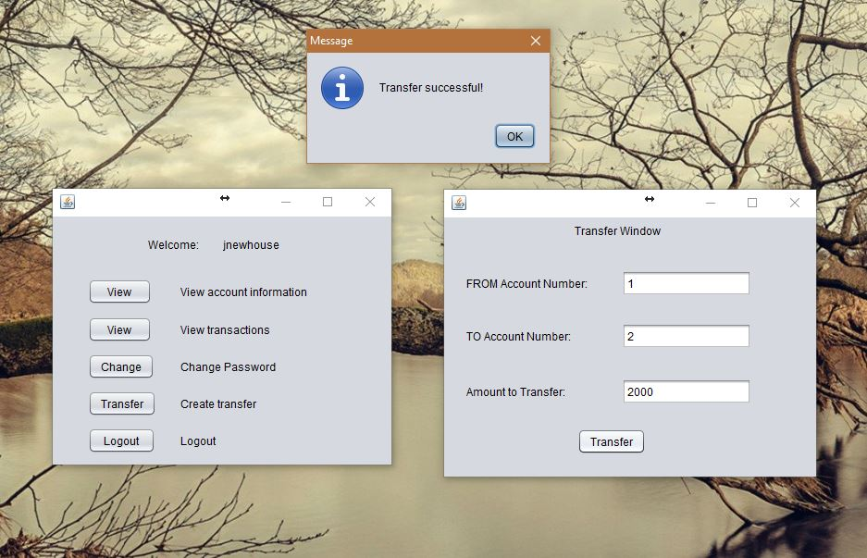
GUI Images

Slide 15
Conclusion
Learned how to create an instance of MySQL on AWS and how to connect with it from different locations, environments, and applications.
Learned how to use JDBC in Java, run different kind of queries and DDL, and reinforced the process of creating a Java Swing application.
Content with the result of the project and feel that we can implement databases for future projects.

